Slide 1



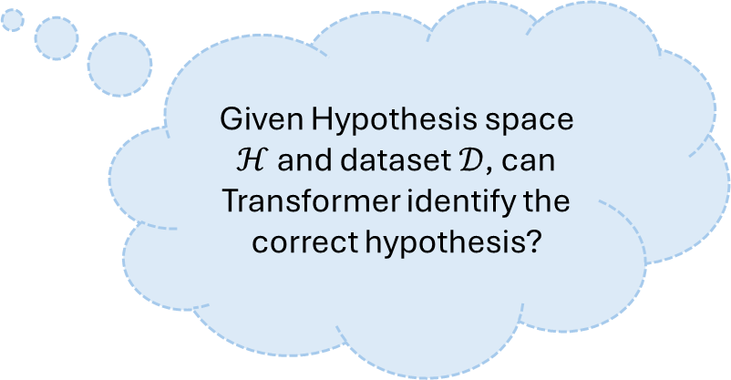
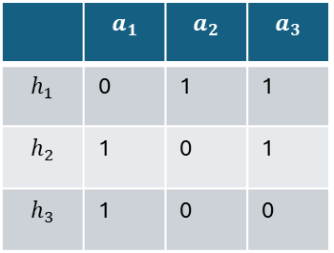





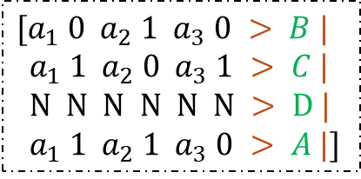

Token Sequence Generated From HMM
0.3
$$x_{t}$$
1
$$x_{t}$$
0.1
0.6
1,0,2,2,1,2,…
Transformer
0.1
0.4
Transformer
0
0.8
2
$$x_{1},x_{2},x_{3},…,x_{t−1}$$
$$x_{1},y_{1},x_{2},y_{2},…,x_{t}$$
0.1
0.6
0.0
Autoregressive Vector Sequence
$$C$$
$$x_{t+1}=f(x_{t})$$
Given Hypothesis space $ℋ$ and dataset $𝒟$, can Transformer identify the correct hypothesis?
$$ℋ=\{h_{1},h_{2},h_{3}\}$$
Transformer
 | $$a_{1}$$ | $$a_{2}$$ | $$a_{3}$$
$$h_{1}$$ | 0 | 1 | 1
$$h_{2}$$ | 1 | 0 | 1
$$h_{3}$$ | 1 | 0 | 0
$$[a_{1} 0 a_{2} 1 a_{3} 0 > B |$$
$a_{1} 1 a_{2} 0 a_{3} 1 > C |$
$N N N N N N > D |$
$a_{1} 1 a_{2} 1 a_{3} 0 > A |]$
$$[ a_{1} 1 a_{2} 0 a_{1} 1 ] >$$
$$𝒟=\{\left(x_{1},1\right),\left(x_{2},1\right)\}$$

Slide 2






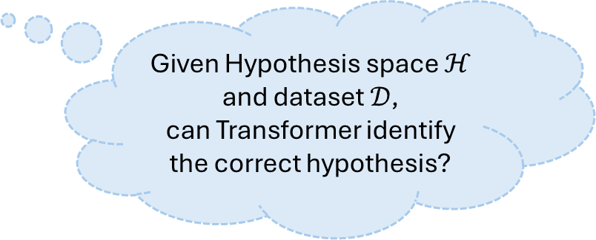



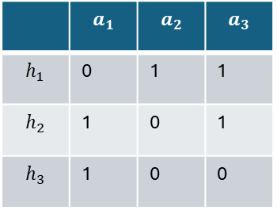


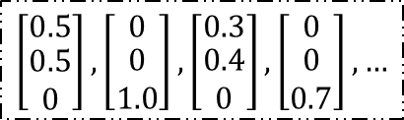
Type 1:
Stochastic Sequence
Type 1:
Paired Sequence
0
1
2
$$y_{t}=f(x_{t})$$
1,0,2,2,1,2,…
$$x_{t}$$
$$x_{t}$$
Common-used
or
$$\left[\begin{matrix}0.5 \\ \begin{aligned}0.5 \\ 0\end{aligned}\end{matrix}\right],\left[\begin{matrix}0 \\ \begin{aligned}0 \\ 1.0\end{aligned}\end{matrix}\right],\left[\begin{matrix}0.3 \\ \begin{aligned}0.4 \\ 0\end{aligned}\end{matrix}\right],\left[\begin{matrix}0 \\ \begin{aligned}0 \\ 0.7\end{aligned}\end{matrix}\right],…$$
Transformer
Transformer
$$x_{t+1}=f(x_{t})$$
$$\left[\begin{matrix}0.5 \\ -0.5\end{matrix}\right],\left[\begin{matrix}0.5 \\ 0.5\end{matrix}\right],\left[\begin{matrix}0.5 \\ −0.5\end{matrix}\right],…$$
$$x_{1},x_{2},x_{3},…,x_{t−1}$$
$$x_{1},y_{1},x_{2},y_{2},…,x_{t}$$
$$𝓗=\{h_{1},h_{2},h_{3}\}$$
$$h_{?}$$
Given Hypothesis space $ℋ$
and dataset $𝒟$,
can Transformer identify the correct hypothesis?
 | $$a_{1}$$ | $$a_{2}$$ | $$a_{3}$$
$$h_{1}$$ | 0 | 1 | 1
$$h_{2}$$ | 1 | 0 | 1
$$h_{3}$$ | 1 | 0 | 0
Transformer
This work
hypothesis prefix
$$x_{1},y_{1},x_{2},y_{2},…,x_{t},y_{t},>$$
$$𝓓={\left\{(x_{i},y_{i})\right\}}_{i=1}^{t}$$

Slide 3




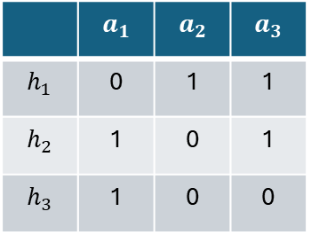

Type 1: Stochastic Sequence
Type 2: Paired Sequence
0
1
2
$$y_{t}=f(x_{t})$$
1,0,2,2,1,2,…
$$x_{t}$$
$$x_{t}$$
Common-used
or
Transformer
$$\left[\begin{matrix}0.5 \\ \begin{aligned}0.5 \\ 0\end{aligned}\end{matrix}\right],\left[\begin{matrix}0 \\ \begin{aligned}0 \\ 1.0\end{aligned}\end{matrix}\right],\left[\begin{matrix}0.3 \\ \begin{aligned}0.4 \\ 0\end{aligned}\end{matrix}\right],\left[\begin{matrix}0 \\ \begin{aligned}0 \\ 0.7\end{aligned}\end{matrix}\right],…$$
Transformer
$$x_{t+1}=f(x_{t})$$
$$\left[\begin{matrix}0.5 \\ -0.5\end{matrix}\right],\left[\begin{matrix}0.5 \\ 0.5\end{matrix}\right],\left[\begin{matrix}0.5 \\ −0.5\end{matrix}\right],…$$
$$x_{1},x_{2},x_{3},…,x_{t−1}$$
$$x_{1},y_{1},x_{2},y_{2},…,x_{t}$$
$$𝓗=\{h_{1},h_{2},h_{3}\}$$
$$h_{?}$$
Given Hypothesis space $𝓗$
and dataset $𝓓$,
can Transformer identify the correct hypothesis?
 | $$a_{1}$$ | $$a_{2}$$ | $$a_{3}$$
$$h_{1}$$ | 0 | 1 | 1
$$h_{2}$$ | 1 | 0 | 1
$$h_{3}$$ | 1 | 0 | 0
Transformer
This work
hypothesis prefix
$$x_{1},y_{1},x_{2},y_{2},…,x_{t},y_{t},>$$
$$𝓓={\left\{(x_{i},y_{i})\right\}}_{i=1}^{t}$$

Slide 4




Existing Common used Synthetic Data
$$x_{t}$$
$$x_{t}$$
Transformer
Transformer
$$x_{1},x_{2},x_{3},…,x_{t−1}$$
$$x_{1},y_{1},x_{2},y_{2},…,x_{t}$$

